Slide 1


DEVOPS
Presented By: Submitted To:
SHREYA PANDEY Dr. Prateek Raj Gautam
500109641
BTECH CSE CCVT
BATCH-4

Slide 2
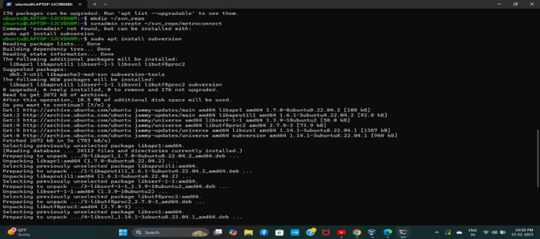
SUBVERSION
​
Install SVN:

Slide 3
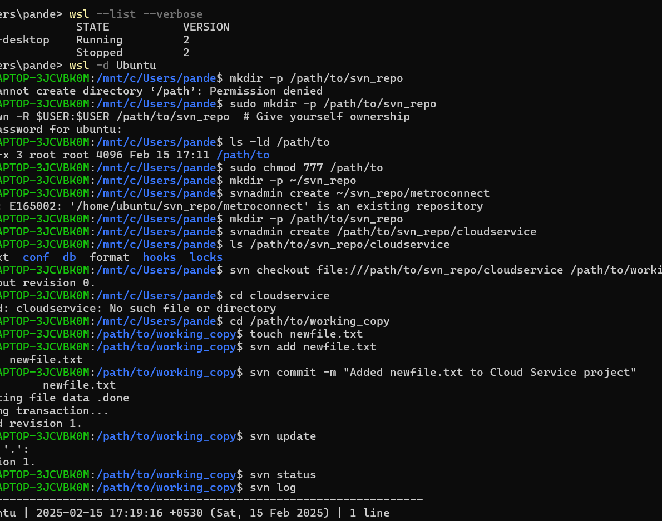
Set up SVN repository in Ubuntu:
Create a Directory for Your Repository:
1.sudo mkdir -p /path/to/svn_repo
2.sudo chown -R $USER:$USER /path/to/svn_repo # Give yourself ownership.
Check Directory Permissions:
ls -ld /path/to
sudo chmod 777 /path/to
Choose a Different Location:
mkdir -p ~/svn_repo
svnadmin create ~/svn_repo/cloudservice
Navigate to Your Working Directory:
cd /path/to/working_copy
Add a New File:
touch newfile.txt
svn add newfile.txt

Slide 4
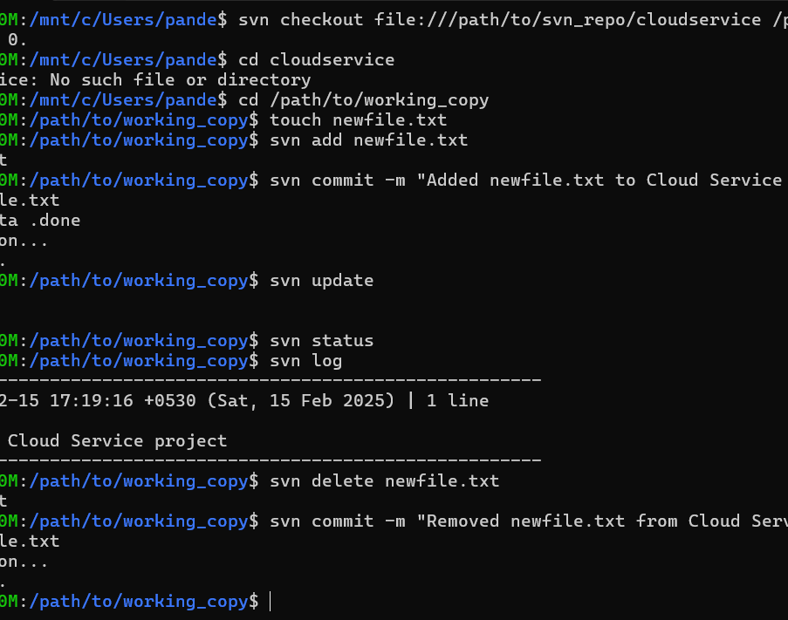
Commit the Change:
svn commit -m "Added newfile.txt to Cloud Service project“
Update Your Working Copy:
svn update
Check Repository Status:
svn status
View Commit Logs:
svn log
Delete a File:
svn delete newfile.txt
Commit the Deletion:
svn commit -m "Removed newfile.txt from Cloud Service project"

Slide 5
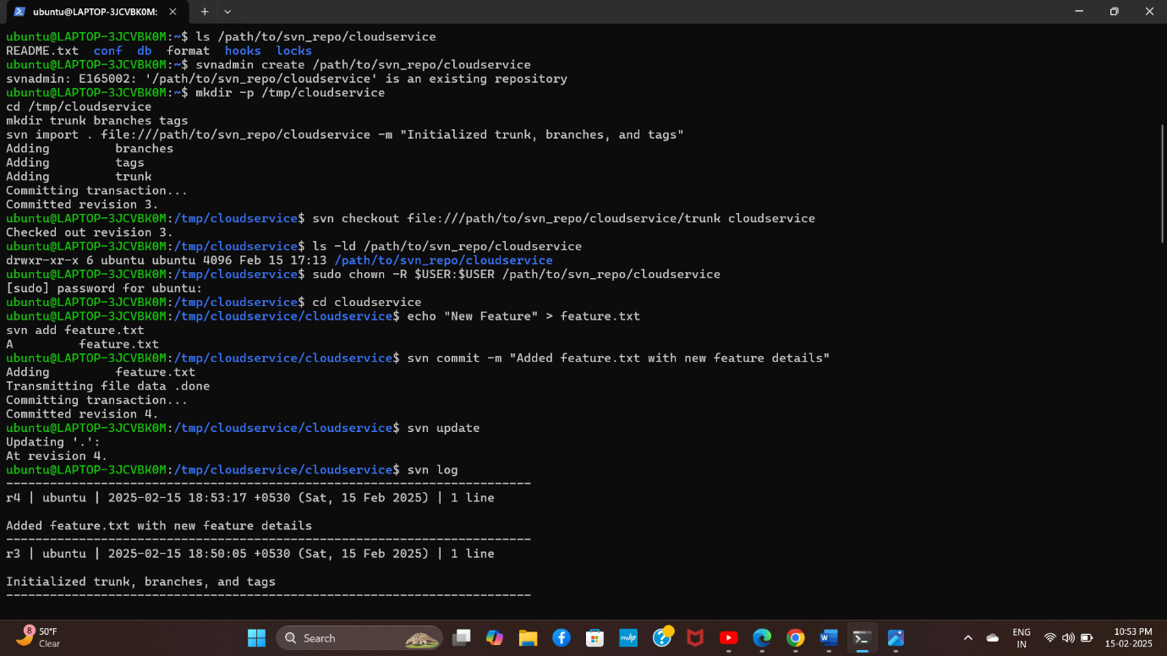
DEVELOP A TRUNK

Slide 6
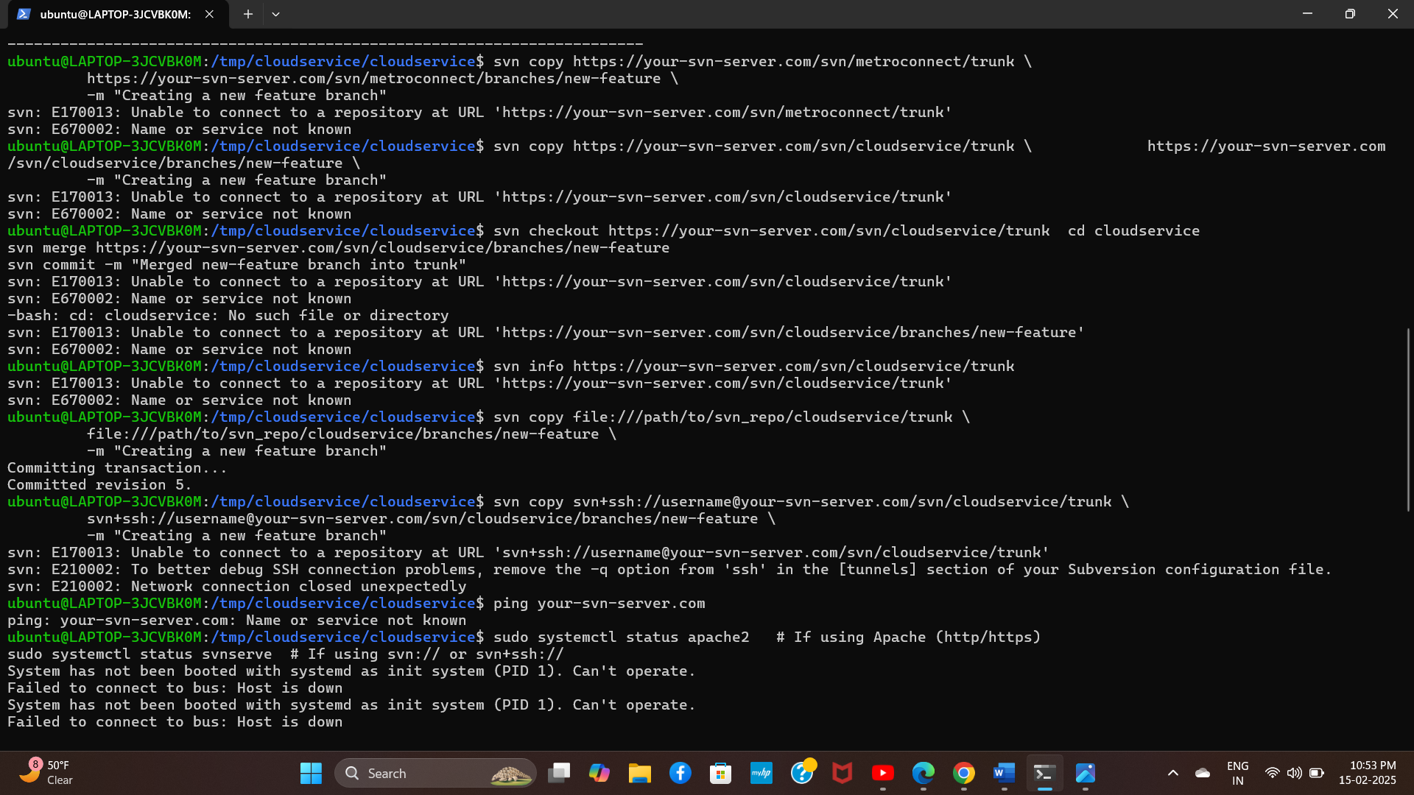

Slide 7
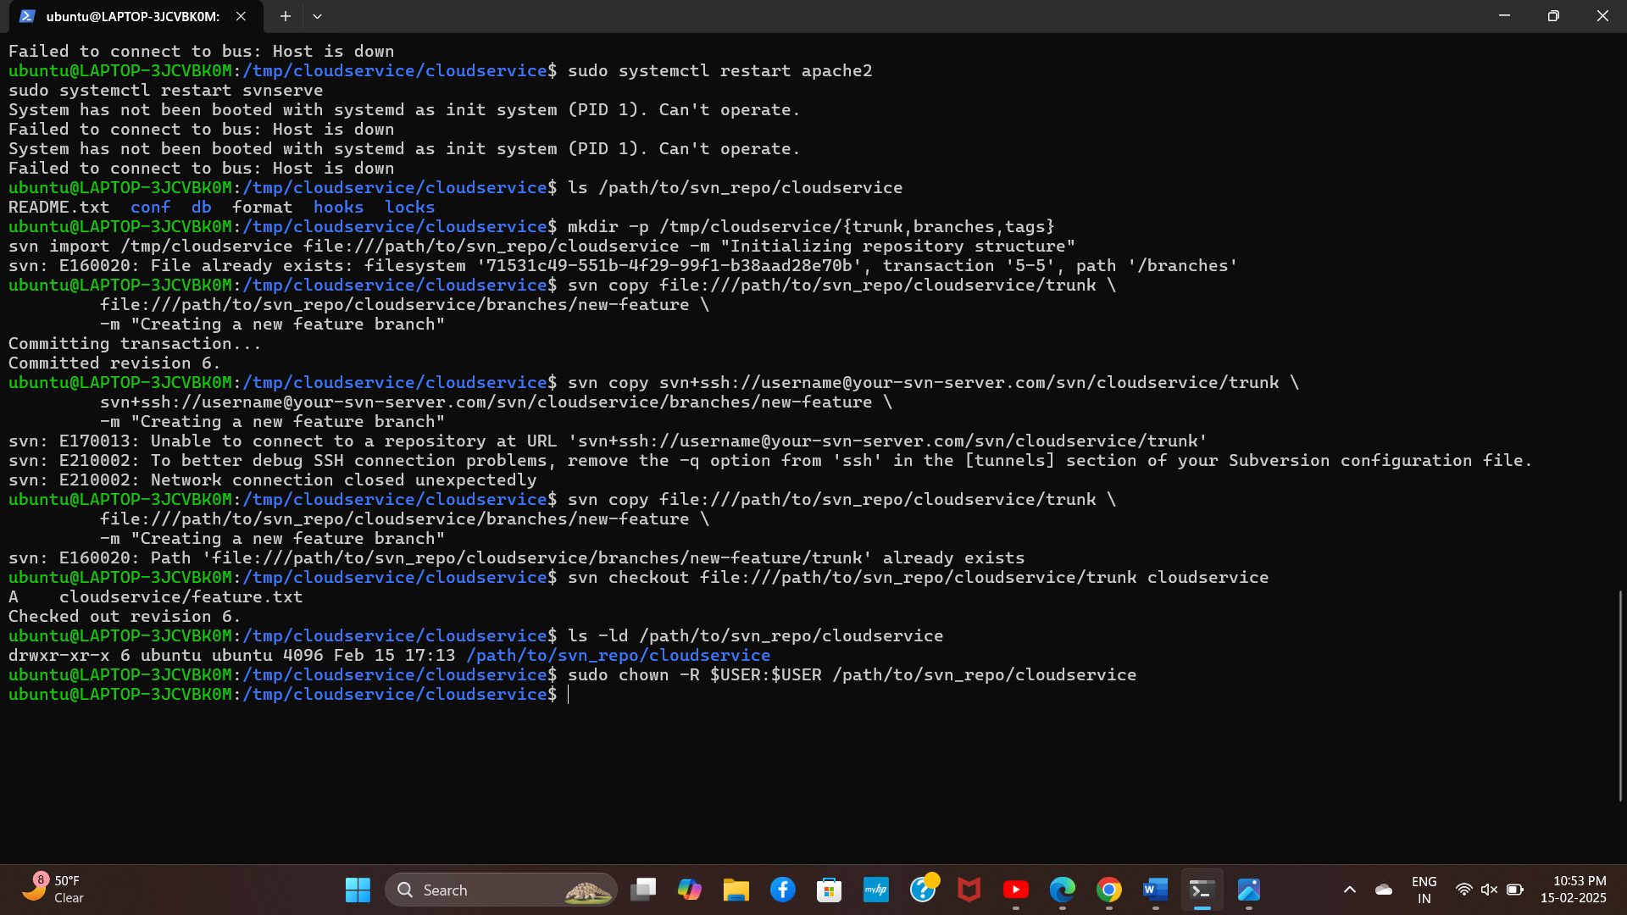

Slide 8
Creating trunk from clientside
Checkout the Repository Root:
svn checkout file:///path/to/svn_repo/cloudservice cloudservice
Create the Trunk Directory Locally:
cd cloudservice
mkdir trunk branches tags
Add Trunk to Version Control
svn add trunk branches tags
Commit the Changes to Create Trunk on the Server
svn commit -m "Created trunk, branches, and tags for CloudService project"
Verify the Trunk Exists
unk

Slide 9
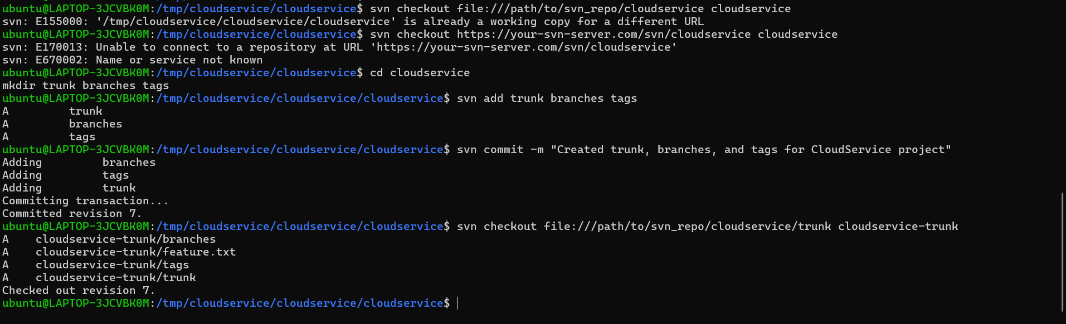

Slide 10
Creating trunk from serverside
Create the SVN Repository on the Server:
svnadmin create /path/to/svn_repo/cloudservice
Create Trunk, Branches, and Tags Directories:
mkdir -p /tmp/cloudservice/{trunk,branches,tags}
Import the Directory Structure into SVN
svn import /tmp/cloudservice file:///path/to/svn_repo/cloudservice -m "Initialized trunk, branches, and tags for CloudService“
Verify the Trunk Exists
svn list file:///path/to/svn_repo/cloudservice
Checkout Trunk from Client-Side
svn checkout file:///path/to/svn_repo/cloudservice/trunk cloudservice

Slide 11
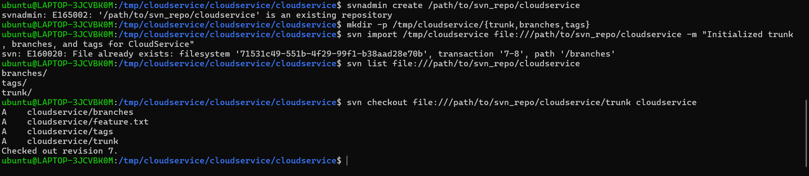

Slide 12
Creating trunk using working copy
Checkout the Repository Root:
svn checkout file:///path/to/svn_repo/cloudservice cloudservice
cd cloudservice
Create the Trunk Directory
mkdir trunk
svn add trunk
Move Files to Trunk (If Needed)
svn move * trunk/
Verify the Trunk Structure:
svn list file:///path/to/svn_repo/cloudservice

Slide 13
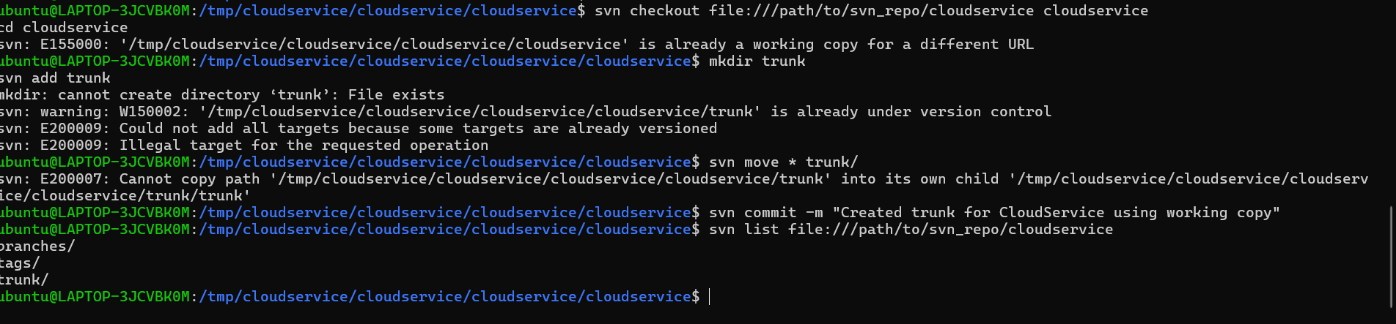

Slide 14
MERCURIAL
Install TortoiseHg
Open TortoiseHg Workbench
Create a New Repository:
Create file
create new repository
choose destination folder where you want repository
click create
Verify the Repository:
Navigate to the repository folder.
A hidden .hg directory should be inside , indicating the successful setup.
Add & Commit Files
.

Slide 15
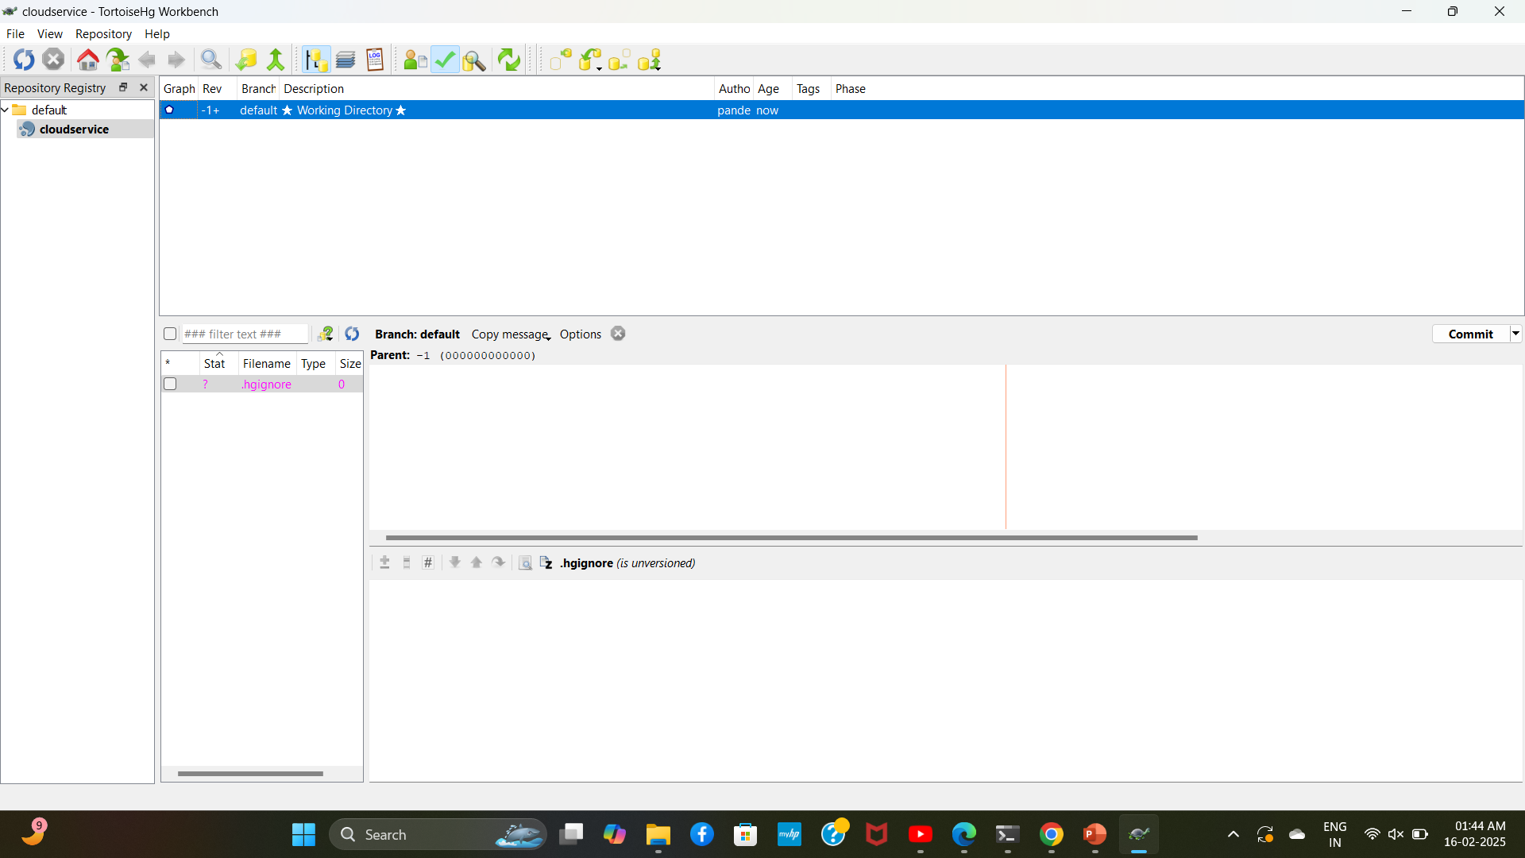

Slide 16
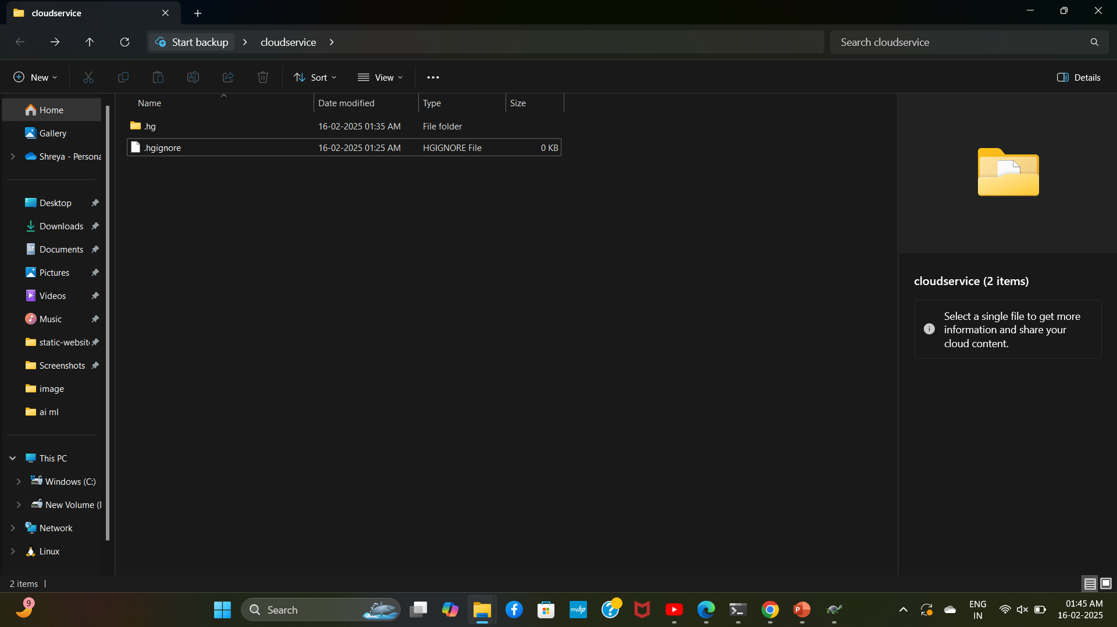

Slide 17
THANK YOU

